Slide 1

Data Structures and Algorithms
(CS221)
Merge Sort

Slide 2
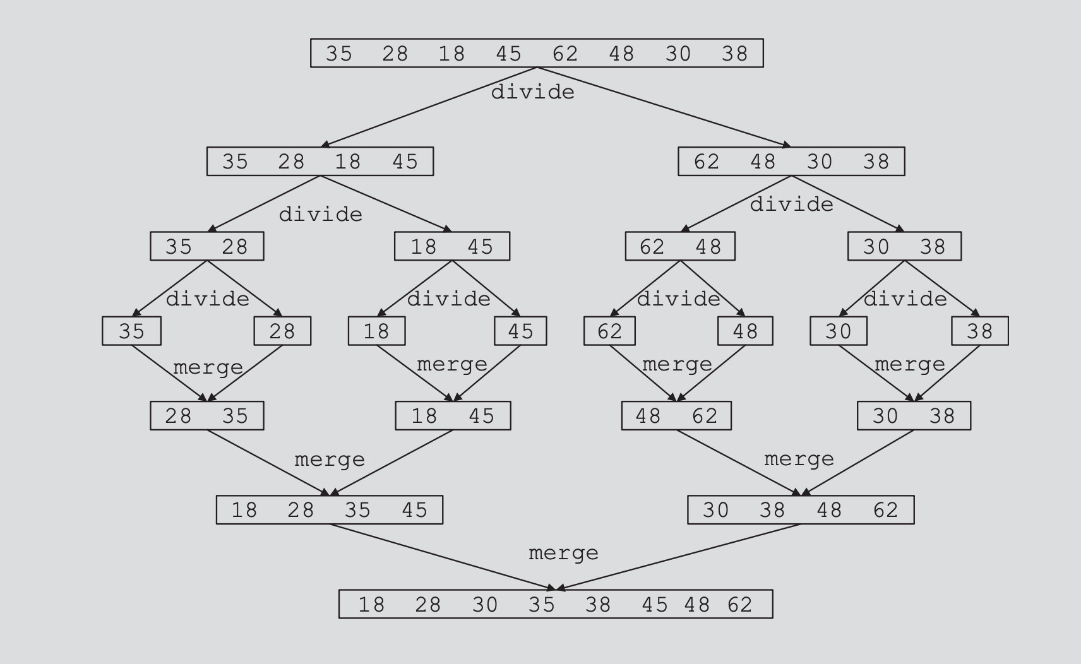

Slide 3
Merge Sort
The fundamental operation in this algorithm is merging two sorted lists.
Because the lists are sorted, this can be done in one pass through the input, if the output is put in a third list.
The basic merging algorithm takes
two input arrays: a and b,
an output array: c
three counters: aptr, bptr, and cptr,
which are initially set to the beginning of their respective arrays.
The smaller of a[aptr] and b[bptr] is copied to the next entry in c, and the appropriate counters are advanced.
When either input list is exhausted, the remainder of the other list is copied to c.
3

Slide 4
Merge Sort : Example
1 ⁽⁰⁾ | 13 ⁽¹⁾ | 24 ⁽²⁾ | 26 ⁽³⁾
2 ⁽⁰⁾ | 15 ⁽¹⁾ | 27 ⁽²⁾ | 38 ⁽³⁾
aptr
bptr
cptr
4

Slide 5
Merge Sort : Example
1 ⁽⁰⁾ | 13 ⁽¹⁾ | 24 ⁽²⁾ | 26 ⁽³⁾
2 ⁽⁰⁾ | 15 ⁽¹⁾ | 27 ⁽²⁾ | 38 ⁽³⁾
aptr
bptr
1 ⁽⁰⁾
cptr
5

Slide 6
Merge Sort : Example
1 ⁽⁰⁾ | 13 ⁽¹⁾ | 24 ⁽²⁾ | 26 ⁽³⁾
2 ⁽⁰⁾ | 15 ⁽¹⁾ | 27 ⁽²⁾ | 38 ⁽³⁾
aptr
bptr
1 ⁽⁰⁾ | 2 ⁽¹⁾
cptr
6

Slide 7
Merge Sort : Example
1 ⁽⁰⁾ | 13 ⁽¹⁾ | 24 ⁽²⁾ | 26 ⁽³⁾
2 ⁽⁰⁾ | 15 ⁽¹⁾ | 27 ⁽²⁾ | 38 ⁽³⁾
aptr
bptr
1 ⁽⁰⁾ | 2 ⁽¹⁾ | 13 ⁽²⁾
cptr
7

Slide 8
Merge Sort : Example
1 ⁽⁰⁾ | 13 ⁽¹⁾ | 24 ⁽²⁾ | 26 ⁽³⁾
2 ⁽⁰⁾ | 15 ⁽¹⁾ | 27 ⁽²⁾ | 38 ⁽³⁾
aptr
bptr
1 ⁽⁰⁾ | 2 ⁽¹⁾ | 13 ⁽²⁾ | 15 ⁽³⁾
cptr
8

Slide 9
Merge Sort : Example
1 ⁽⁰⁾ | 13 ⁽¹⁾ | 24 ⁽²⁾ | 26 ⁽³⁾
2 ⁽⁰⁾ | 15 ⁽¹⁾ | 27 ⁽²⁾ | 38 ⁽³⁾
aptr
bptr
1 ⁽⁰⁾ | 2 ⁽¹⁾ | 13 ⁽²⁾ | 15 ⁽³⁾ | 24 ⁽²⁾
cptr
9

Slide 10
Merge Sort : Example
1 ⁽⁰⁾ | 13 ⁽¹⁾ | 24 ⁽²⁾ | 26 ⁽³⁾
2 ⁽⁰⁾ | 15 ⁽¹⁾ | 27 ⁽²⁾ | 38 ⁽³⁾
aptr
bptr
1 ⁽⁰⁾ | 2 ⁽¹⁾ | 13 ⁽²⁾ | 15 ⁽³⁾ | 24 ⁽²⁾ | 26 ⁽³⁾
cptr
10

Slide 11
Merge Sort : Example
1 ⁽⁰⁾ | 13 ⁽¹⁾ | 24 ⁽²⁾ | 26 ⁽³⁾
2 ⁽⁰⁾ | 15 ⁽¹⁾ | 27 ⁽²⁾ | 38 ⁽³⁾
aptr
bptr
1 ⁽⁰⁾ | 2 ⁽¹⁾ | 13 ⁽²⁾ | 15 ⁽³⁾ | 24 ⁽⁴⁾ | 26 ⁽⁵⁾ | 27 ⁽⁶⁾ | 38 ⁽⁷⁾
cptr
11

Slide 12
Merge Sort
void m_sort( input_type a[], input_type tmp_array[ ], int left, int right )
{
int center;
if( left < right )
{
center = (left + right) / 2;
m_sort( a, tmp_array, left, center );
m_sort( a, tmp_array, center+1, right );
merge( a, tmp_array, left, center+1, right );
}
}
Calculate the centre index of the input list
Recursively call the m_sort procedure
for the left-half of the input data
Recursively call the m_sort procedure
for the right-half of the input data
Merge the two sorted lists
12

Slide 13
Merge Sort Example (recursive Function Calls)
Mergesort(a, 8)
m_sort( a, tmp_array, 0, 7 )
62 ⁽⁰⁾ | 58 ⁽¹⁾ | 55 ⁽²⁾ | 10 ⁽³⁾ | 45 ⁽⁴⁾ | 44 ⁽⁵⁾ | 6 ⁽⁶⁾ | 90 ⁽⁷⁾
Merge(a, tmp_array, 0, 4, 7 )
m_sort( a, tmp_array, 0, 3)
m_sort( a, tmp_array, 4, 7)
62 ⁽⁰⁾ | 58 ⁽¹⁾ | 55 ⁽²⁾ | 10 ⁽³⁾
45 ⁽⁴⁾ | 44 ⁽⁵⁾ | 6 ⁽⁶⁾ | 90 ⁽⁷⁾
62 ⁽⁰⁾ | 58 ⁽¹⁾
55 ⁽²⁾ | 10 ⁽³⁾
45 ⁽⁴⁾ | 44 ⁽⁵⁾
6 ⁽⁶⁾ | 90 ⁽⁷⁾
m_sort(0, 1)
m_sort(2, 3 )
m_sort(4, 5)
m_sort(6, 7 )
Merge(a, tmp_array, 0, 2, 3 )
Merge(a, tmp_array, 4, 6, 7 )
62 ⁽⁰⁾
58 ⁽¹⁾
55 ⁽²⁾
10 ⁽³⁾
45 ⁽⁴⁾
44 ⁽⁵⁾
6 ⁽⁶⁾
90 ⁽⁷⁾
m_sort(0,0)
m_sort(1,1)
m_sort(2,2)
m_sort(3,3)
m_sort(4,4)
m_sort(5,5)
m_sort(6,6)
m_sort(7,7)
Merge(0, 1, 1 )
Merge(2, 3, 3 )
Merge(4, 5, 5 )
Merge(6, 7, 7 )
13

Slide 14
Merge Sort Example (Merging process)
Mergesort(a, 8)
m_sort( a, tmp_array, 0, 7 )
62 ⁽⁰⁾ | 58 ⁽¹⁾ | 55 ⁽²⁾ | 10 ⁽³⁾ | 45 ⁽⁴⁾ | 44 ⁽⁵⁾ | 6 ⁽⁶⁾ | 90 ⁽⁷⁾
6 ⁽⁰⁾ | 10 ⁽¹⁾ | 44 ⁽²⁾ | 45 ⁽³⁾ | 55 ⁽⁴⁾ | 58 ⁽⁵⁾ | 62 ⁽⁶⁾ | 90 ⁽⁷⁾
Merge(a, tmp_array, 0, 4, 7 )
m_sort( a, tmp_array, 0, 3)
m_sort( a, tmp_array, 4, 7)
62 ⁽⁰⁾ | 58 ⁽¹⁾ | 55 ⁽²⁾ | 10 ⁽³⁾
45 ⁽⁴⁾ | 44 ⁽⁵⁾ | 6 ⁽⁶⁾ | 90 ⁽⁷⁾
62 ⁽⁰⁾ | 58 ⁽¹⁾
55 ⁽²⁾ | 10 ⁽³⁾
45 ⁽⁴⁾ | 44 ⁽⁵⁾
6 ⁽⁶⁾ | 90 ⁽⁷⁾
m_sort(0, 1)
m_sort(2, 3 )
m_sort(4, 5)
m_sort(6, 7 )
10 ⁽⁰⁾ | 55 ⁽¹⁾ | 58 ⁽²⁾ | 62 ⁽³⁾
6 ⁽⁴⁾ | 44 ⁽⁵⁾ | 45 ⁽⁶⁾ | 90 ⁽⁷⁾
Merge(a, tmp_array, 0, 2, 3 )
Merge(a, tmp_array, 4, 6, 7 )
62 ⁽⁰⁾
58 ⁽¹⁾
55 ⁽²⁾
10 ⁽³⁾
45 ⁽⁴⁾
44 ⁽⁵⁾
6 ⁽⁶⁾
90 ⁽⁷⁾
m_sort(0,0)
m_sort(1,1)
m_sort(2,2)
m_sort(3,3)
m_sort(4,4)
m_sort(5,5)
m_sort(6,6)
m_sort(7,7)
Merge(0, 1, 1 )
Merge(2, 3, 3 )
Merge(4, 5, 5 )
Merge(6, 7, 7 )
58 ⁽⁰⁾ | 62 ⁽¹⁾
10 ⁽²⁾ | 55 ⁽³⁾
44 ⁽⁴⁾ | 45 ⁽⁵⁾
6 ⁽⁶⁾ | 90 ⁽⁷⁾
14

Slide 15
Merge Sort : Example
50 ⁽⁰⁾ | 100 ⁽¹⁾ | 3 ⁽²⁾ | 70 ⁽³⁾ | 4 ⁽⁴⁾ | 80 ⁽⁵⁾ | 6 ⁽⁶⁾ | 66 ⁽⁷⁾ | 85⁸
15

Slide 16
Questions?
zahmaad.github.io

